Slide 1
HARAMAYA UNIVERSITY
Library Management System
Data Structures & Algorithms in C++
Linked List
Stack
Queue
Hash Map
Group 4 · Department of Computer Science

Slide 2
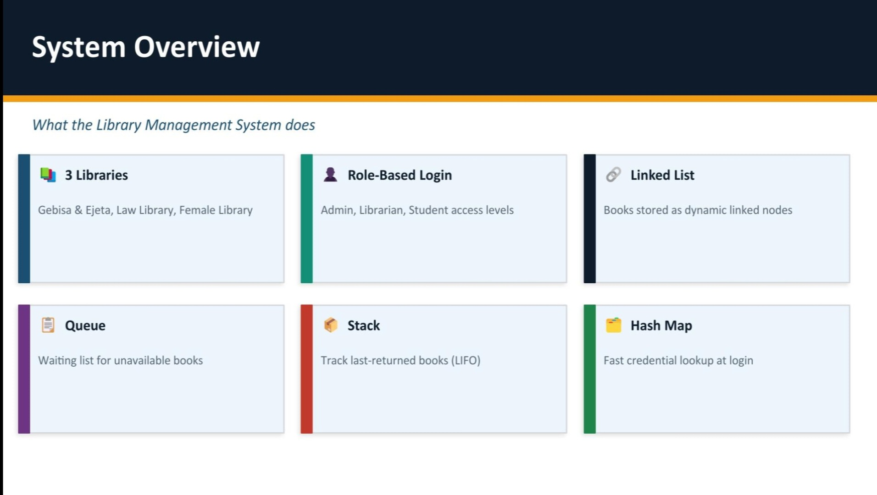

Slide 3
System Overview
3 Libraries
Role-Based Login
Book Management
Gebisa & Ejeta · Law Library · Female Library
Admin, Librarian & Student access levels
Add, search, display, borrow & return books
Waiting Queue
Return Stack
Linked List
Fair FIFO queue for unavailable books
LIFO stack tracks last-returned for quick shelving
All books stored as dynamic linked nodes

Slide 4
Data Structures Used
Four carefully chosen structures power every library operation
1
Linked List
Stores all books in each library as dynamically linked nodes
Insert O(n) · Search O(n)
2
Queue (FIFO)
Manages the waiting list of students for unavailable books
Enqueue O(1) · Dequeue O(1)
3
Stack (LIFO)
Tracks returned books so the most recent is shelved first
Push O(1) · Pop O(1)
4
Hash Map
unordered_map stores credentials for O(1) login authentication
Lookup O(1) average

Slide 5
1. Linked List — Book Storage
id
Unique number to identify each book
struct Book {
int id;
string title;
string category;
int totalCopies;
int availableCopies;
Book* next; // → next node
};
title
Book name used in search
category
Genre / subject (e.g. Science, Law)
totalCopies
How many copies the library owns
availableCopies
Copies currently on the shelf
next →
Pointer linking to the next Book node
How Books Form a Chain:
Book A
Book B
Book C
NULL
addBook() appends at tail · searchBook() uses linear search O(n)

Slide 6
2. Queue (FIFO) — Waiting Students
struct QueueNode {
int studentId;
int bookId;
QueueNode* next;
};
// Operations
void enqueue(int sid, int bid); // O(1)
void dequeue(); // O(1)
Purpose
When a book is unavailable, the student is placed at the back of the queue automatically.
FIFO Guarantee
First student to join is first to receive the book when it becomes available.
Enqueue O(1)
Creates a QueueNode and appends it to the rear pointer — constant time.
Dequeue O(1)
Removes front node when book is returned and frees memory — constant time.
Queue Visualization (FIFO — First In, First Out):
Student 1
(front)
Student 2
Student 3
(rear)
← dequeue (book becomes available)
enqueue (new student waits) →

Slide 7
3. Stack (LIFO) — Returned Books
struct StackNode {
int bookId;
string title;
StackNode* next;
};
// Operations
void push(int bid, string t); // O(1)
void pop(); // O(1)
Purpose
Every returned book is pushed onto the stack so librarians can shelve it.
LIFO Behavior
Most recently returned book is always processed first (top of stack).
Push O(1)
Creates a StackNode prepended to returnStack — constant time insert.
Pop O(1)
Removes the top node (shelfReturnedBook()) and frees memory.
Stack Visualization (LIFO — Last In, First Out):
Book C ← TOP (returned last, shelved FIRST)
Book B
Book A (returned first, shelved last)
← push() / pop() operates on TOP only

Slide 8
4. Hash Map — Login Authentication
Username
Password
Role
unordered_map<string,string>
credentials = {
{"admin", "libadmin"},
{"librarian","lib123" },
{"student", "stud2025"},
};
// Lookup: O(1) average
credentials.find(username);
admin
libadmin
Administrator
librarian
lib123
Librarian
student
stud2025
Student
Login Flow:
① User enters username & password
② unordered_map.find(username) — checks existence
③ Compare stored password — validate
④ Set user role on success | Reject invalid credentials
Why unordered_map? Faster than linear search through a list — O(1) average lookup

Slide 9
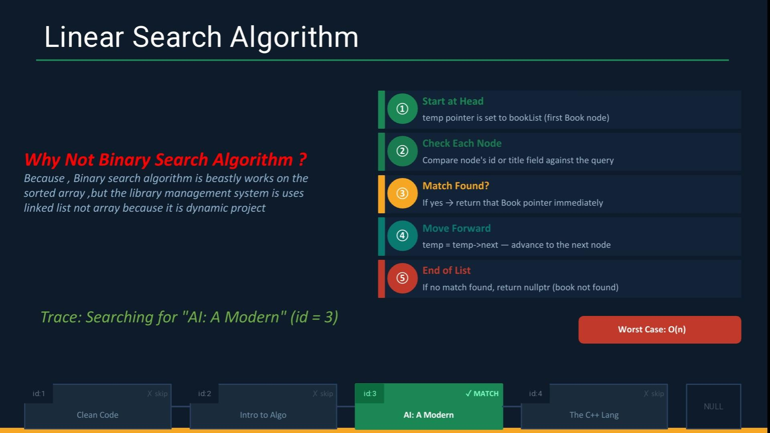

Slide 10
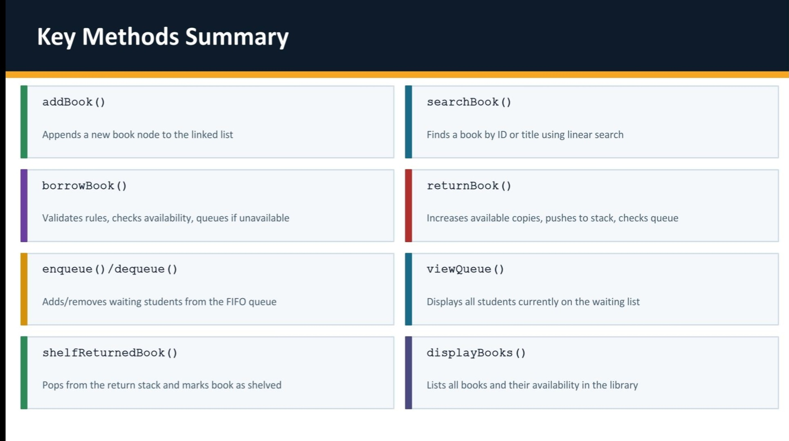

Slide 11
System Workflow
Borrow Process
Return Process
1
Select Library
1
Book Returned
User picks one of 3 libraries
Student returns the book
2
Verify Student
2
Update Copies
Check student exists in records
Increment availableCopies
3
Check Borrow Limit
3
Push to Stack
Students ≤3 books · Teachers ≤100
returnStack.push(book) for shelving
4a
Book Available
4
Check Queue
Decrement availableCopies → done
If student waiting → auto-dequeue & lend
4b
Book Unavailable
5
Shelf Book
Enqueue student in waiting queue
shelfReturnedBook() pops stack

Slide 12
Algorithm Complexity Summary
Operation
Data Structure
Complexity
Where Used
Add Book
Linked List
O(n)
addBook()
Search Book
Linked List
O(n)
searchBook()
Student Enqueue
Queue
O(1)
enqueue()
Student Dequeue
Queue
O(1)
dequeue()
Push Return
Stack
O(1)
push()
Shelf Book
Stack
O(1)
pop()
Login Auth
Hash Map
O(1) avg
credentials.find()

Slide 13
Conclusion
1
Linked List
Books stored as dynamic nodes — flexible insert & search
2
Queue (FIFO)
Fair waiting list — first student waits, first to be served
3
Stack (LIFO)
Returned books tracked — most recent shelved first
4
Hash Map
O(1) credential lookup — fast & efficient authentication
Haramaya University · Group 4 · Data Structures in C++

